Slide 1

BURGERNOMICS

Slide 2

What does the syllabus say?
Global interdependence
linkages between economies, including trade, investment, tourism and immigration
the patterns and trends in global trade
the concept, and determinants, of international competitiveness
the concept, and extent, of globalisation
the factors facilitating globalisation
economic effects of globalisation

Slide 3

Learning intention
We are learning about the interdependence of nations in a global economy.

Slide 4

Success criteria
DEFINE the term purchasing power parity.
CALCULATE the PPP of a nation using the Big Mac Index.
EXPLAIN what the PPP of a nation reveals about its international competitiveness.

Slide 5
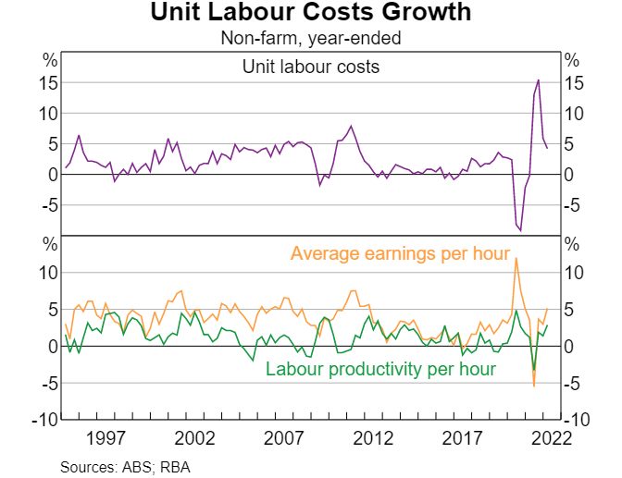
Let’s get started…
Examine the source to the right then complete the following:
IDENTIFY the relationship between unit labour costs and labour productivity between 2020 to 2022.
DESCRIBE the overall trend in unit labour costs between 2020 and 2022.
DISCUSS the effect of this change in unit labour costs on Australia’s international competitiveness.

Slide 6

Key vocabulary
purchasing power parity
international competitiveness
over or under valued
exchange rate

Slide 7

What is meant by PPP?
Purchasing power parity refers to the idea that the same product should sell for the same price in different countries, once converted to a common exchange rate.

Slide 8

Time to think…
Name some products that are sold worldwide with little variation that might be used to calculate PPP.

Slide 9
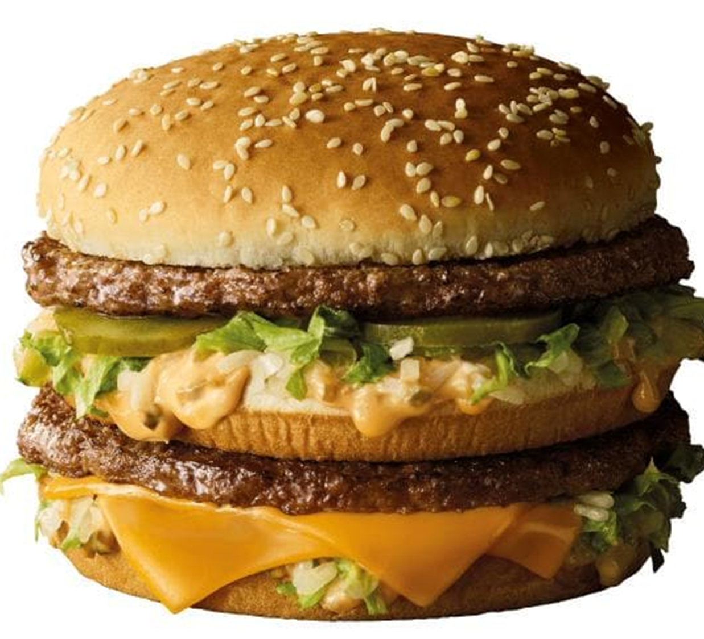
What is the Big Mac Index?
Under the principle of PPP if you buy a Big Mac in the US ($5.15) it should cost the same as purchasing a Big Mac in Australia ($6.70) once the currency has been converted (1USD = 1AUD) assuming that both currencies are correctly valued.

Slide 10
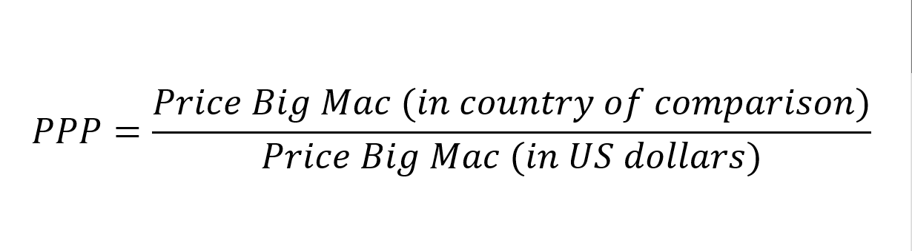
Calculating the PPP?
To calculate PPP you divide the value of the burger in the country you are comparing to that of the value of the local Big Mac calculated in the comparison currency.
i.e. in our example we are dividing the value of the Big Mac produced in Australia ($6.70 AUD) to the value of the Big Mac produced in America in ($5.15USD).

Slide 11
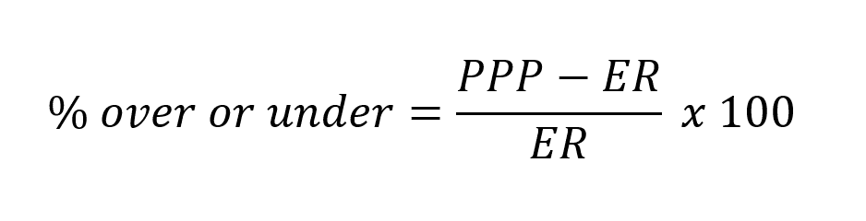
Is the currency correctly valued?
When you compare actual exchange rates with the PPP rate it is possible to identify whether a currency is over or under valued. Theoretically it is more advantageous to trade with a country that is undervalued.
Using our previous example we would compare the PPP for Australia against our actual exchange rate with the US.
In our example the actual exchange rate is 1USD = 1.45AUD.

Slide 12

Need to here this is a different way?
Click on the image to the right in order to view a video which outlines the process for calculating the Big Mac Index.

Slide 13
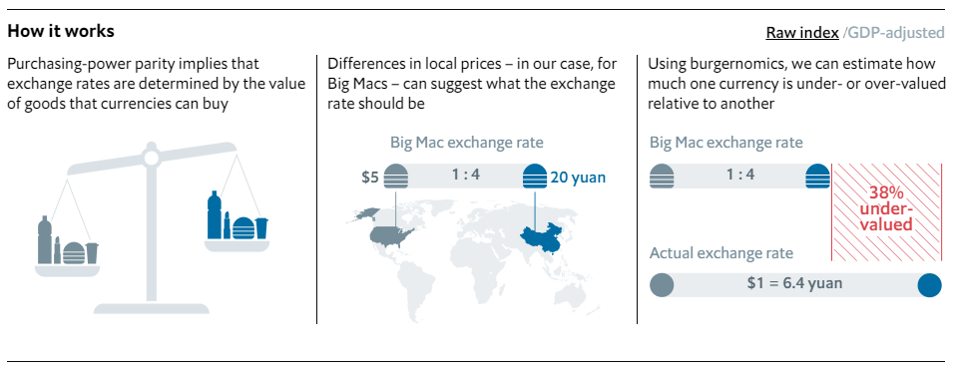
In summary…

Slide 14
Your turn…
Complete each of the following questions with respect to China. Once this is done complete the same three questions for Japan and New Zealand.
CALCULATE the purchasing power parity for Australia and China.
CALCULATE the percentage by which the Australian and Chinese currency were over- or under- valued.
EXPLAIN what this source suggests about the international competitiveness of Australia in comparison to that of China.
 | Local price | Exchange rate | Price USD
Australia | $6.60AUD | 1.45 | $4.55
China | 24 yuan | 6.67 | $3.50
Japan | 390 yen | 137.86 | $2.83
New Zealand | $7.10NZD | 1.60 | $4.44
US | $5.15USD | 1 | $5.15

Slide 15
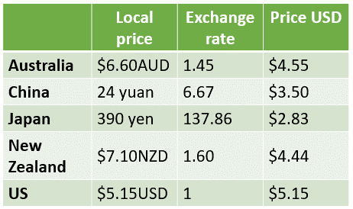
Before you go…
Using your answers from the previous slide list the countries from most to least competitive with respect to their exchange rate.

Slide 16
How can I support my learning from today?
Test your understanding on the success criteria each day. Address any gaps in your learning.
Take Cornell notes on Chapter One of the text organised under the syllabus dot-points.
Complete ISP – Global Interdependence.
Create a glossary of key economic terminology.

Slide 17
Success criteria checklist
I CAN…
DEFINE the term purchasing power parity?
CALCULATE the PPP of a nation using the Big Mac Index?
EXPLAIN what the PPP of a nation reveals about its international competitiveness?

